Slide 1
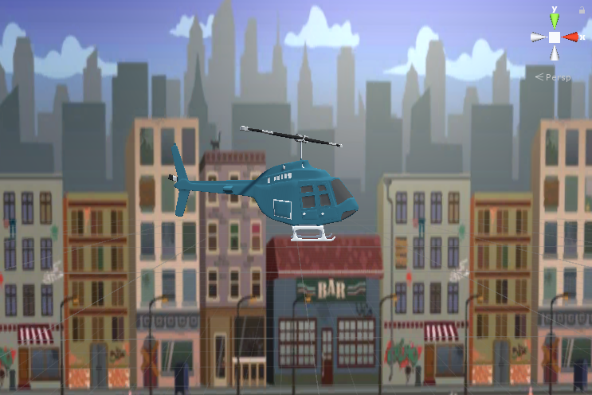
Γραφικά Υπολογιστών και Ανάπτυξη Παιχνιδιών
Unity Game
Βασίλης Γκόλες

Slide 2
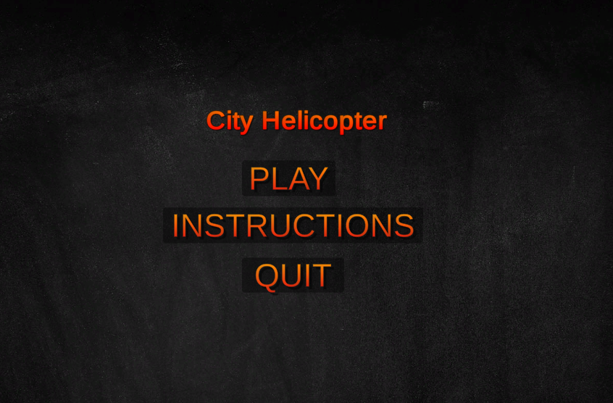
Game’s Starting Menu

Slide 3
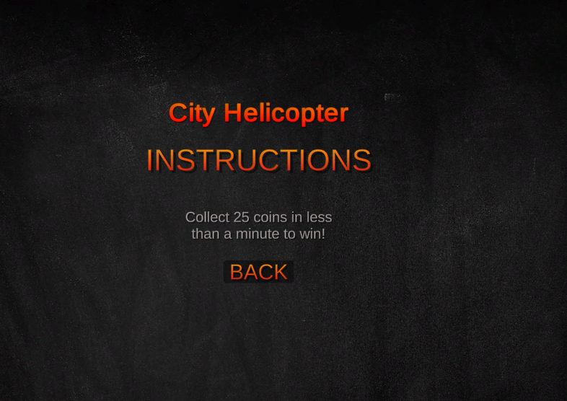
Switching Between Menus

Slide 4
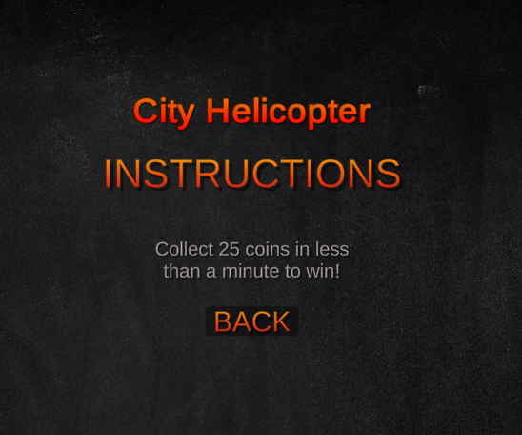
Goal Of The Game

Slide 5
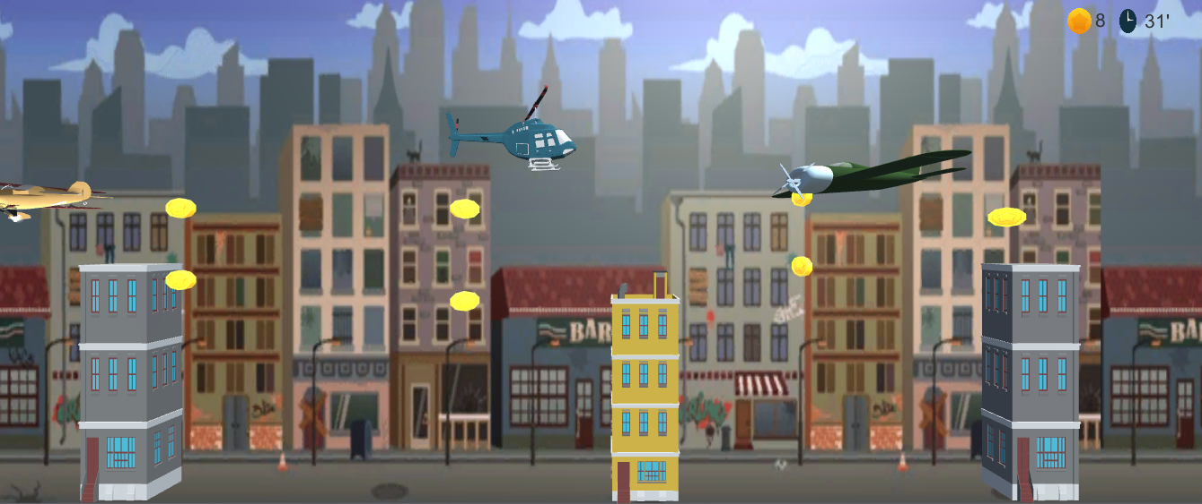
Game Running

Slide 6
Game Running
Prefabs and models being rendered.
Displays coin status
Display timer info

Slide 7
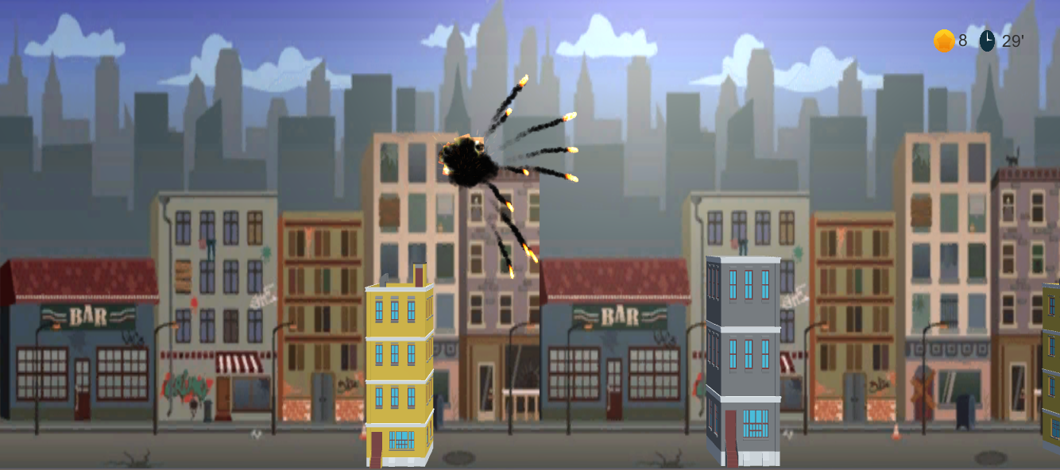
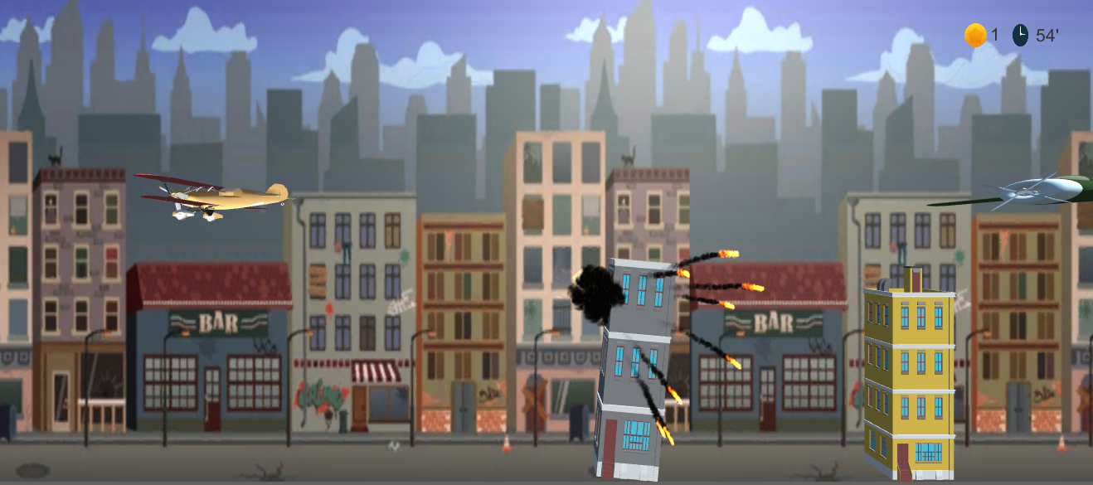
Two Ways To Lose The Game
Crash with a copter
Crash with a building
Display explosion effect on both times.

Slide 8
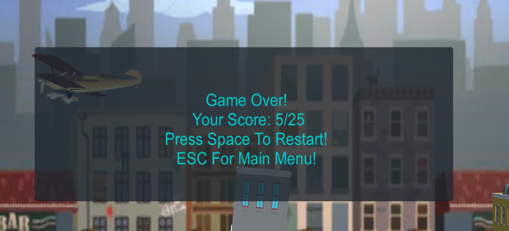
Display Info Panel When Lose
Display score
Give two options:
1. Restart the game
2. Go to Main Menu

Slide 9
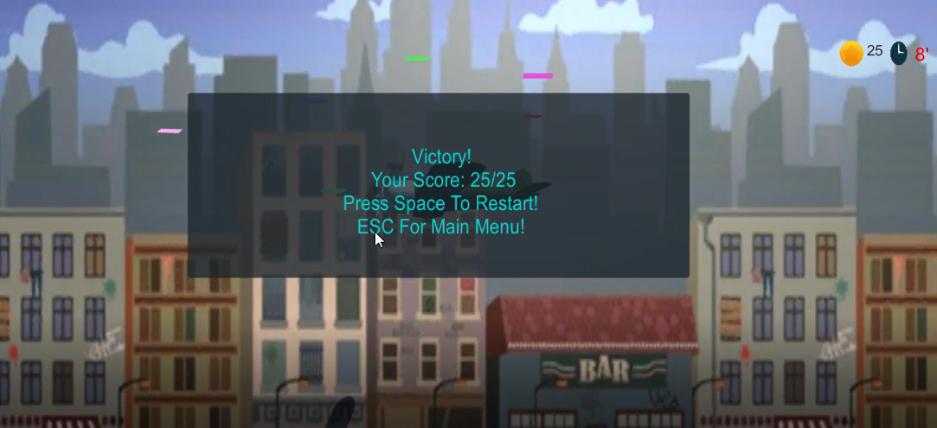
Display Effect When Won The Game

Slide 10

The End
visualparadox.com
10

